Slide 1
Studying the Nervous System
Chapter 1
1

Slide 2
What do I expect to learn today?
Know the difference between neurons and glial cells
Appreciate how shapes of neurons facilitate their function
Discuss different functions of glial cells
Recognize few techniques used in study of NS and differentiate between them
2

Slide 3

Assigned reading from Purves
Cellular components of the nervous system – page 2
Neurons – page 5
Glial cells – page 7
Functional analysis of neural systems – page 21
3

Slide 4

Cellular component of the nervous system

Slide 5

Cellular component of the nervous system
cell was recognized as the fundamental unit of all living organisms
nervous tissue, like all other organs, is made up of these fundamental units
Some biologists of that era : nerve cell was connected to its neighbors by protoplasmic links forming = reticulum ---- Italian pathologist Camillo
Golgi championed this *reticular theory*
This mistake notwithstanding : Golgi contribution in medical science :
identifying the cellular organelle eventually called : Golgi apparatus
developing the critically important cell staining technique that bears his name
and contributing to the understanding of the pathophysiology of malaria
characterized by a fine network

Slide 6
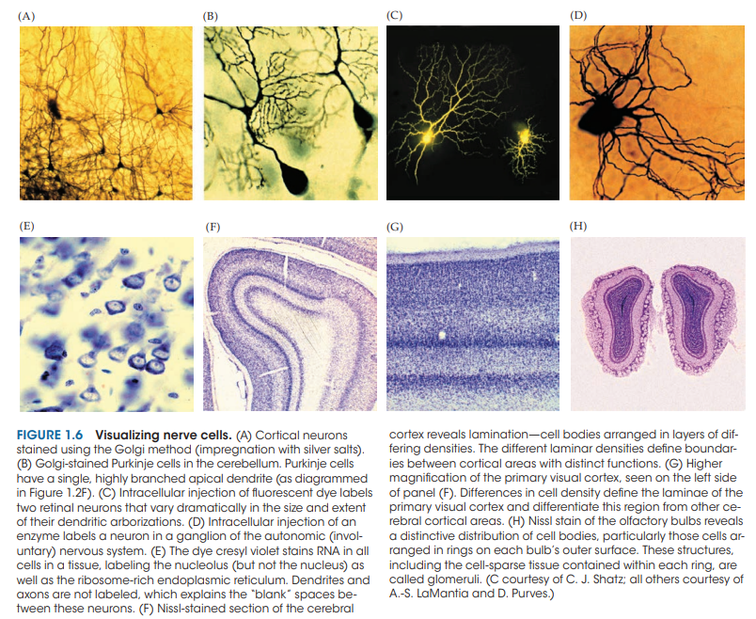
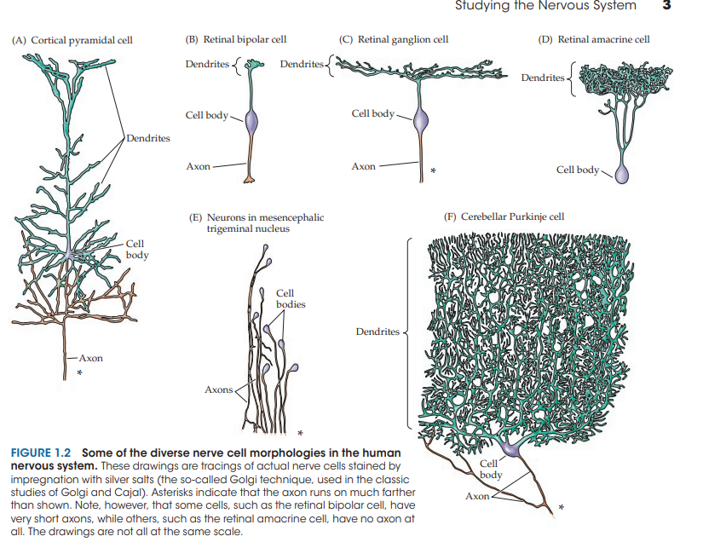
Golgi contributions : figure ( 1.6 ) / figure ( 1.2 )
Explained
Explained later

Slide 7
Reticular theory fell from favor – then replaced by neuron doctrine - proponents of this doctrine = Spanish neuroanatomist Santiago Ramón y Cajal + British physiologist Charles Sherrington
Golgi and Cajal spirited debate : passed on light microscope + salting with silver salts [ Golgi method ]
Result : Cajal said =
neurons are discrete entities communicate by * specialized contacts * that are NOT sites of continuity between cells
Sherrington : working on the apparent transfer of electrical signals via reflex pathways called this Specialized contacts of Cajal = synapses
Result : Cajal triumph over Golgi , but both awarded Nobel prizes , also Sherrington
full of energy
separate
being

Slide 8
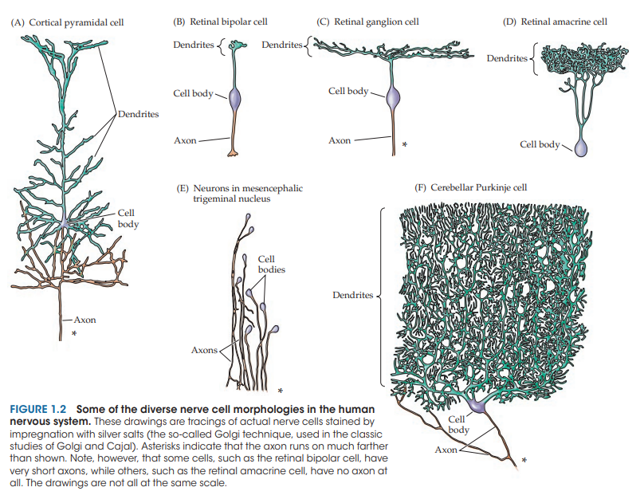
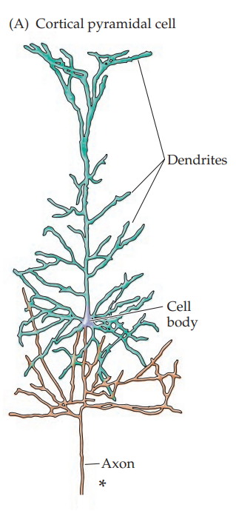
nerve cell morphologies :
Tracing by silver salts / Golgi Technique
Used in classic Golgi & Cajal
Asterisks indicate that the axon runs on much farther than shown.

Slide 9
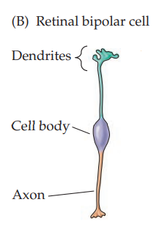
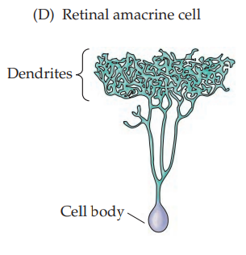
Note, retinal bipolar cell, have very short axons, retinal amacrine cell, have no axon at all. The drawings are not all at the same scale.

Slide 10
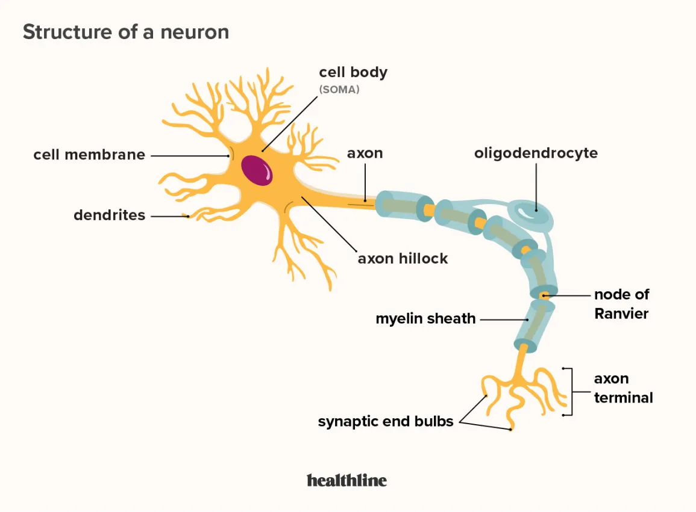
Neurons

Slide 11
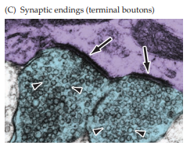
Intro
Most neurons are distinguished by :
their specialization for long-distance electrical signaling
intercellular communication by means of synapses
These attributes are apparent in the
overall morphology of neurons
organization of their membrane components
structural and functional intricacies of the synaptic contacts between neurons

Slide 12
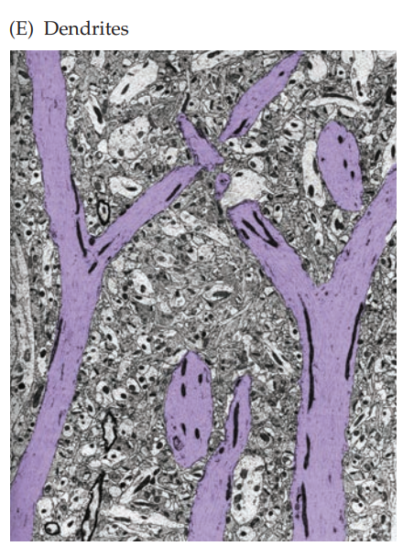
The most obvious morphological
sign of neuronal specialization for communication is the extensive branching of neurons
The two most salient aspects of this branching for typical nerve cells are the :
presence of an axon
elaborate arborization of dendrites that arise from the neuronal cell body in the form of dendritic branches (or dendritic processes; see Figure 1.3E)
AXONS :
Most neurons have only one axon
that extends for a relatively long distance from
the location of the cell body
Axons may have branches, but in general they are
not as elaborate as those made by dendrites
most noticeable

Slide 13
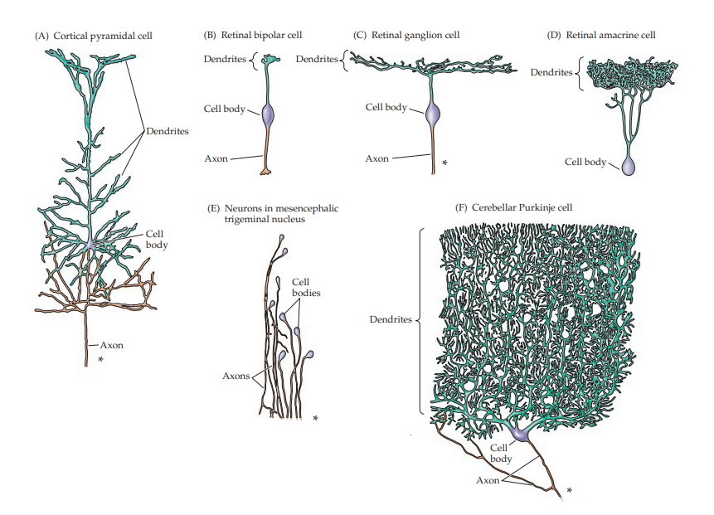
Dendrites :
Dendrites are the primary targets for synaptic input from the axon terminals of other neurons
Distinguished by their high content of ribosomes, as well as by specific cytoskeletal proteins
The variation In the size and branching of dendrites is
enormous : critical importance in establishing the information-processing capacity of individual neurons
Some neurons lack dendrites altogether, while others have dendritic branches that rival the complexity of a mature tree , Example :

Slide 14
The number of inputs a particular neuron receives depends on the ? complexity of its dendritic arbor :
Neurons that LACK dendrites are : innervated by the axons of just one or a few other neurons → which limits their capacity to integrate information from diverse sources → thus leading to more or less faithful relay of the electrical activity generated by the synapses impinging on the neurons
Neurons with increasingly ELABORATE dendritic branches → innervated by a commensurately larger number of other neurons → allows for far greater integration of information
number of inputs to a single neuron reflects the degree of convergence
number of targets innervated by any one neuron represents its divergence
The number of synaptic inputs received by each nerve cell in the human nervous system varies from 1 to about 100,000 , This range reflects? a fundamental purpose of nerve cells: to integrate and relay information from other neurons in a neural circuit
coordinate
accurate
strike

Slide 15
The synaptic contacts made by axon endings on dendrites
(and less frequently on ? neuronal cell bodies) represent a special elaboration of the secretory apparatus found in many polarized epithelial cells
the axon terminal of the presynaptic neuron is immediately adjacent to a specialized region of postsynaptic receptors on the target cell.
the majority of synapses, there is NO physical continuity between these two elements :INSTEAD, pre- and postsynaptic components communicate via the secretion of molecules from the presynaptic terminal that bind to receptors in the postsynaptic cell. These molecules, called neurotransmitters must traverse an interval of extracellular space between pre- and postsynaptic elements called the synaptic cleft
The synaptic cleft is not simply an empty space
site of extracellular proteins that influence the diffusion, binding, and degradation of the molecules, including neurotransmitters and other factors, secreted by the presynaptic terminal

Slide 16
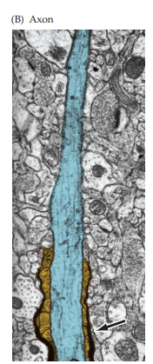
The axon is the portion of the nerve cell specialized for relaying electrical signals over long distances
The information conveyed by synapses on the neuronal dendrites
is integrated and generally “read out” at the origin of the axon
(called the axon)
The axon is a unique extension from the neuronal cell body that
may travel a few hundred micrometers or much farther, depending on the
type of neuron
the size of the animal (some axons in large animals can be meters in length)
BUT !! Many nerve cells in the human brain have axons no more than a few millimeters long, and a few have no axon at all.
The axon also has : a distinct cytoskeleton whose elements are central for its functional integrity

Slide 17
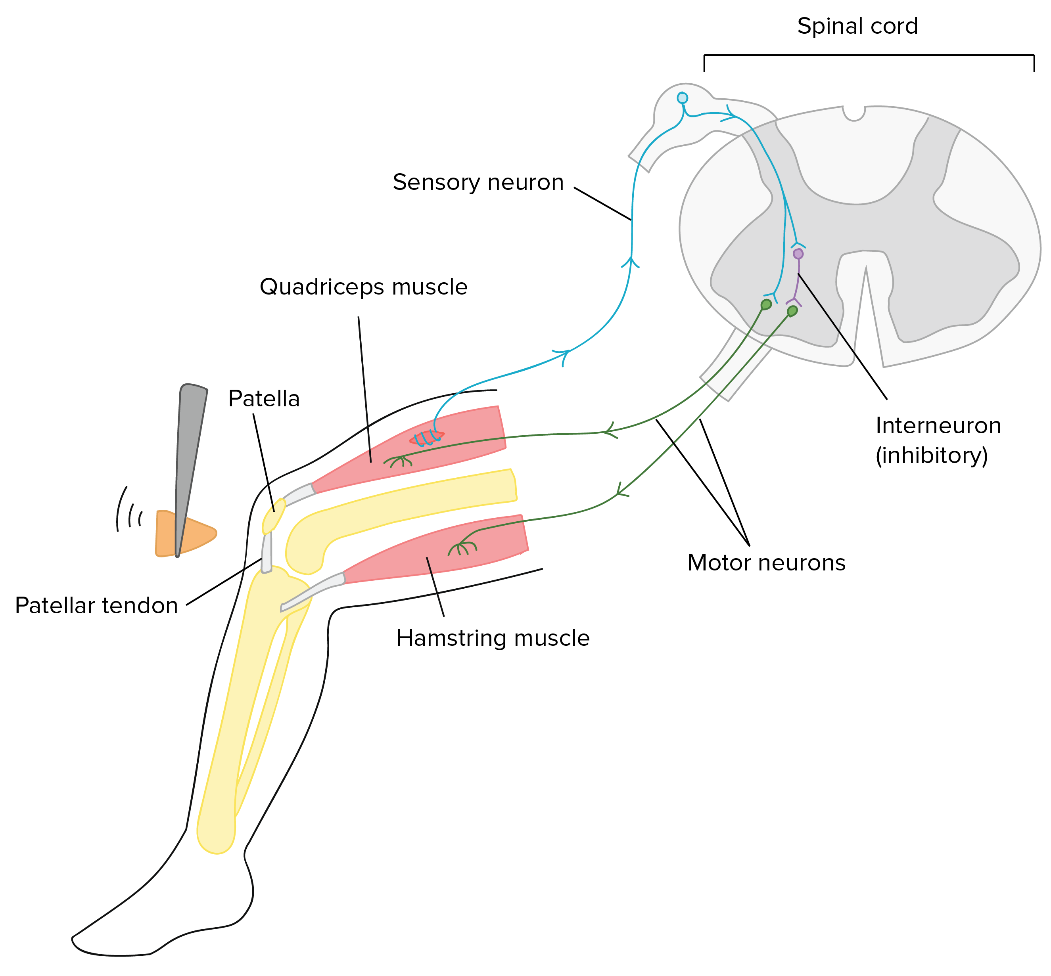
Axons length :
short axons are a feature of local circuit neurons, or interneurons
axons of Projection Neurons extend to distant targets
EXAMPLE : axons that run from the human spinal cord to the foot are about a meter long.
The axons of both interneurons and projection neurons often branch locally, resulting in the innervation of multiple post-synaptic sites on many post-synaptic neurons.
FUNCTION : Axons convey electrical signals over such distances by a self-regenerating wave of electrical activity called an action potential.

Slide 18
Action potentials (also referred to as “spikes” or “units”)
Action potentials are all-or-nothing changes in the electrical potential (voltage) across the nerve cell membrane that conveys information from one place to another in the nervous system
The process by which the information encoded by action potentials is passed on at synaptic contacts to a target cell is called synaptic transmission
Presynaptic terminals (also called synaptic endings, axon terminals, or terminal boutons ) and their postsynaptic specializations are typically chemical synapses, the most abundant type of synapse in the mature nervous system
electrical synapse
(mediated by the gap junctions mentioned above)
is relatively rare in the mature nervous system
(but abundant in the developing CNS)
serves special functions, including the synchronization of local networks of neurons.

Slide 19
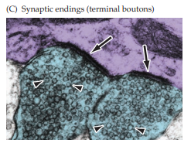
The secretory organelles in the presynaptic terminal of
chemical synapses are called synaptic vesicles :
Are spherical structures
filled with neurotransmitters / in some cases other neuroactive molecules
The positioning of synaptic vesicles at the presynaptic membrane + their fusion to initiate neurotransmitter release are regulated by ? a variety of proteins (including several cytoskeletal proteins) either in or associated with the vesicle
The neurotransmitters released from synaptic vesicles modify the electrical properties of the target cell by binding to receptors localized primarily at postsynaptic specializations
The intricate interplay of neurotransmitters, receptors,
related cytoskeletal elements, and signal transduction molecules is the basis for communication among nerve cells and
between nerve cells and effector cells in muscles and glands.

Slide 20
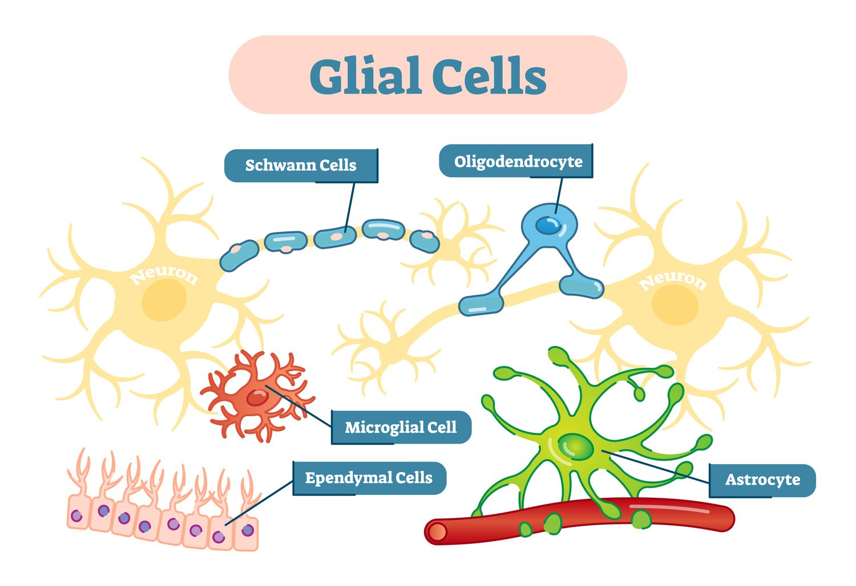
Glial Cells

Slide 21
FUNCTION / INTRO
Glial cells—usually referred to more simply as glia
quite different from neurons / BUT as abundant
Glia do not participate directly in synaptic transmission or in electrical signaling,
their supportive functions help define synaptic contacts and maintain the signaling abilities of neurons
Structure :
Like nerve cells, many glial cells have complex processes extending from their cell bodies, BUT these are generally less prominent and do not serve the same purposes as neuronal axons and dendrites.
Glial cells and Brain
Cells with glial characteristics the only stem cells retained in the mature brain
capable of giving rise both to new glia /in a few instances, new neurons.

Slide 22
The word glia is Greek for “glue” and reflects the nineteenth-century presumption that these cells “held the nervous system together.”
Is it true ? The term has survived despite the lack of any evidence that glial cells actually bind nerve cells together.
Glial functions that are well established include :
Maintaining the ionic milieu of nerve cells
Modulating the rate of nerve signal propagation
Modulating synaptic action by controlling the uptake and metabolism of neurotransmitters at or near the synaptic cleft
Providing a scaffold for some aspects of neural development
Aiding (or in some instances impeding) recovery from neural injury
Providing an interface between the brain and the immune system
Facilitating the convective flow of interstitial fluid through the brain during sleep, a process that washes out metabolic waste
There are three types of differentiated glial cells in the mature nervous system:
astrocytes
oligodendrocytes
microglial cells

Slide 23
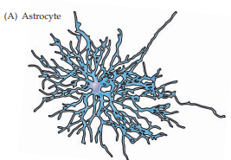
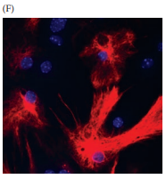
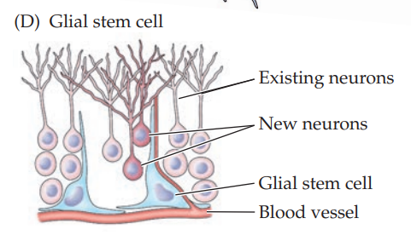

Astrocytes:
Restricted to the central nervous system (i.e., the brain and spinal cord)
have elaborate local processes that give these cells a starlike (“astral”) appearance
A major function :
maintain, in a variety of ways, an appropriate chemical environment for neuronal signaling, including formation of the blood-brain barrier (see the Appendix).
recent observations suggest that : astrocytes secrete substances that influence the construction of new synaptic connections, and that a subset of astrocytes in the adult brain ? retains the characteristics of stem cells

Slide 24
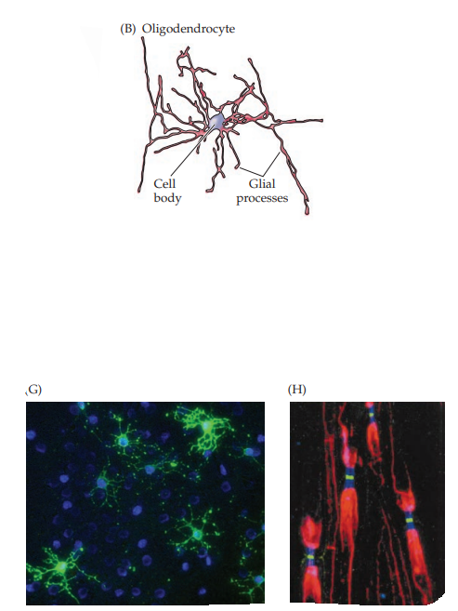
Oligodendrocytes
which are also restricted to the central nervous system
lay down a laminated, lipid-rich wrapping called myelin
around some, BUT not all, axons (Figure 1.5B,G,H).
Myelin has important effects on the speed of the transmission of electrical signals
In the peripheral nervous system, the cells that provide myelin are called Schwann cells.
In the mature nervous system, subsets of oligodendrocytes and Schwann cells ?
retain neural stem cell properties
can generate new oligodendrocytes and Schwann cells in response to injury
or disease

Slide 25
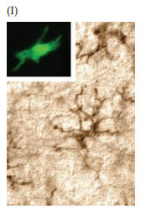
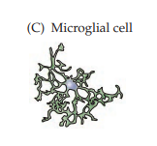
Microglial cells
are derived primarily from hematopoietic precursor cells / (although some may be derived directly from neural precursor cells).
Microglia share many properties with macrophages found in other tissues: They are primarily scavenger cells that remove cellular debris from sites of injury or normal cell turnover.
like their macrophage counterparts,
secrete signaling molecules particularly a wide range of
cytokines that are also produced by cells of the immune
System
modulate local inflammation
influence whether other cells survive or die
some neurobiologists prefer to categorize microglia as a type
of macrophage

Slide 26
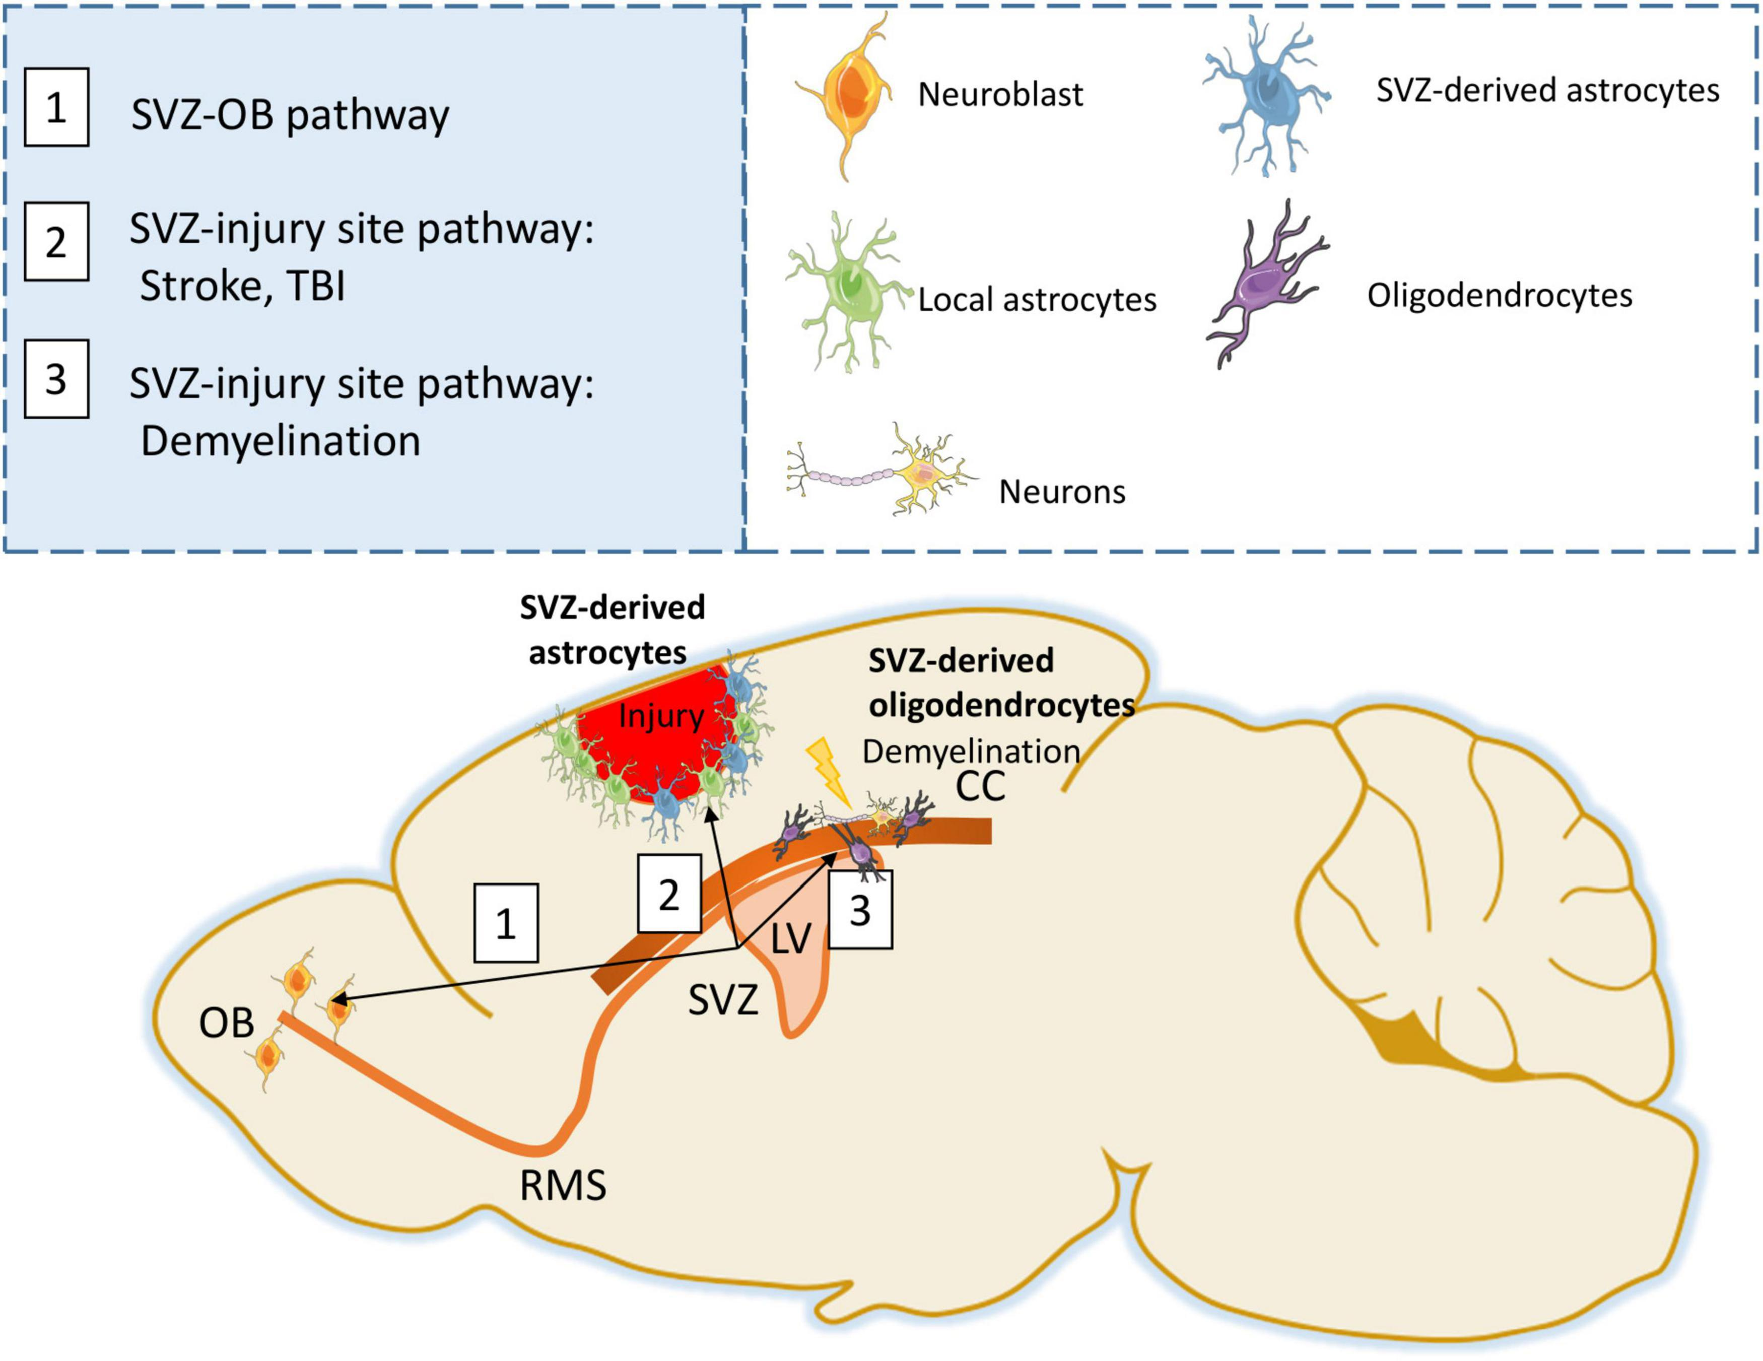
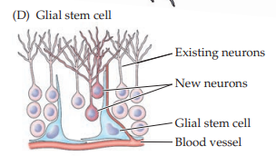
Following brain damage, the number of microglia at the site of injury increases dramatically. Some of these cells proliferate from
microglia resident in the brain
others come from macrophages that migrate to the injured area and enter the brain via local disruptions in the cerebral vasculature (the blood-brain barrier).
In addition to the three classes of differentiated glia, glial stem cells are
also found throughout the adult brain.
these cells retain the capacity to proliferate and generate additional precursors or differentiated glia, and in some cases neurons.
Glial stem cells in the mature brain can be divided into two categories:
a subset of astrocytes found primarily near the ventricles in a region called the subventricular zone (SVZ)
adjacent to ventricular zone blood vessels
See the figure :
and oligodendrocyte precursors scattered
throughout the white matter and
sometimes referred to as polydendrocytes
(D) Glial stem cells in the mature nervous system include stem cells with properties of astrocytes that can give rise to neurons, astrocytes, and oligodendrocytes.

Slide 27
SVZ astrocytes, both in vivo and in vitro ["In vivo" means research done on a living organism, while "in vitro" means research done in a laboratory dish or test tube ],
can give rise to more stem cells, neurons, and mature astrocytes and oligodendrocytes.
they have the key properties of all stem cells: proliferation, self-renewal, and the capacity to make all cell classes of a particular tissue.
Oligodendrocyte precursors
are more limited in their potential
they give rise primarily to mature oligodendrocytes as well as to some astrocytes, although under some conditions in vitro they can generate neurons
The significance of stem cells that retain many molecular characteristics of glia in the mature brain remains unclear.

Slide 28
They may reflect glial identity as the “default” for any proliferative cell derived from the embryonic precursors of the nervous system, or they may reflect distinctions in the differentiated state of neurons versus glia that allow proliferation only in cells with glial characteristics.

Slide 29
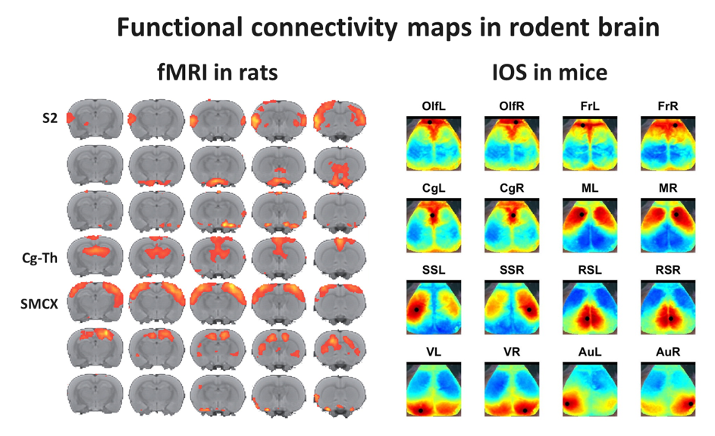
Functional Analysis of Neural Systems

Slide 30
Functional analyses provide another powerful way of understanding the organization of nervous systems.
A variety of physiological methods are now available to evaluate the
electrical and metabolic activity of the neuronal circuits that make up a neural system.
Two approaches
electrophysiological recording
functional brain imaging
Useful in defining : how neural systems convey and represent information.
The most widely used electrophysiological method: single-cell, or single-unit, electrophysiological recording with microelectrodes
This method often records from several nearby cells in addition to the one selected, providing further useful information.

Slide 31
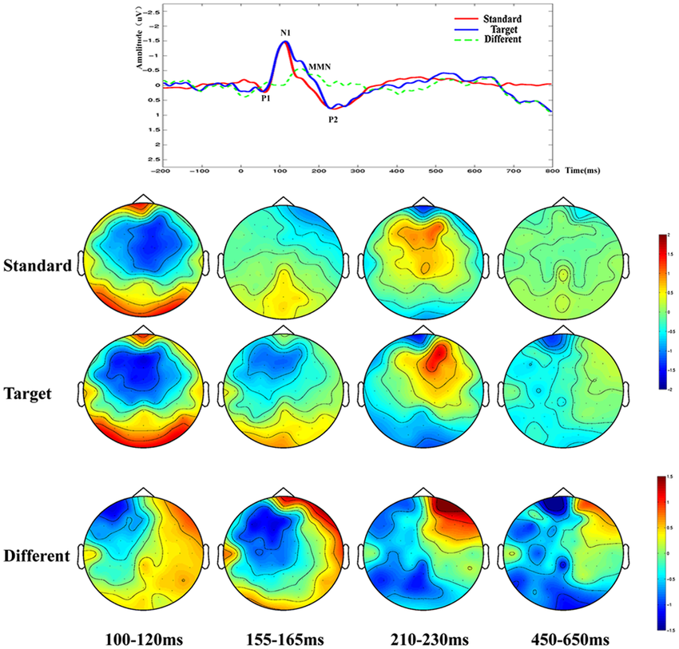
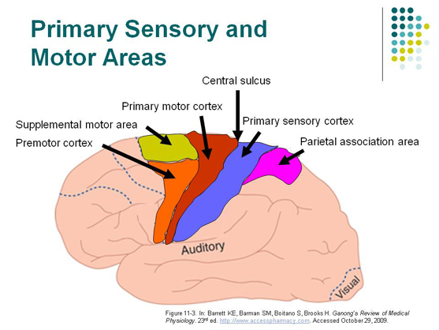
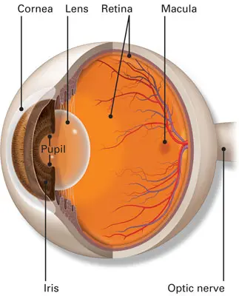
The use of microelectrodes to record action potential activity →
allows cell-by-cell analysis of the organization of topographic
maps
can give specific insight into the type of stimulus to which
the neuron is “tuned” (i.e., the stimulus that elicits a maximal
change in neuronal activity from a baseline state)
Such tuning defines ? a neuron’s receptive field—the region in sensory space (e.g., the body surface or a specialized structure such as the retina) within which a specific stimulus elicits action potential response
History + Scientists improvements :
This way of understanding neural systems was pioneered by Stephen Kuffler and Vernon Mountcastle in the early 1950s
used by several generations of neuroscientists to evaluate the relationship between peripheral stimuli (sensory) or actions (motor) and neuronal responses in both sensory and motor systems

Slide 32
Electrical recording techniques at the single-cell level have been
extended and refined to include single and simultaneous multiple cell analysis in animals performing complex cognitive tasks.
intracellular recordings in intact animals,
the use of patch electrodes to detect and monitor the activity of the individual membrane molecules that ultimately underlie neural signaling
For neurons that are not concerned with space as such, stimulus-selective responses further define receptive field properties that are used to ? categorize neurons.
For example, the response to different odorant molecules can be used to define the preferences of individual neurons in the olfactory system. Such preferences can be identified for any neuron. Thus, a neuron in the visual system, for example, can be tested for preferences to color, motion, and so on, in addition to being tested for its response to stimuli presented in a distinct location in visual space.

Slide 33
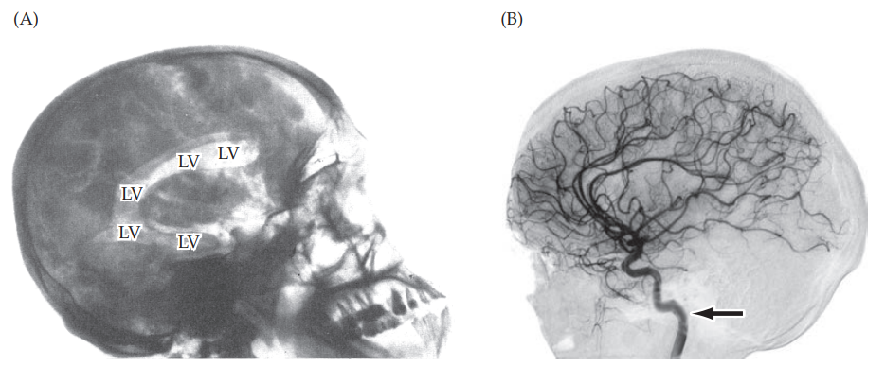
Functional brain imaging
provides another, noninvasive approach for studying neural activity.
Over the last three decades, techniques for brain imaging, → especially in humans (and, to a lesser extent, experimental animals) → have revolutionized our understanding of neural systems and the ability to describe and diagnose functional abnormalities in individuals with brain disorders.
Unlike electrophysiological methods of recording neural activity, which require ? exposing the brain or some other part of the nervous system and inserting electrodes
Brain imaging is thus applicable to both patients and healthy individuals who volunteer for neuroscientific investigations. Current functional imaging methods record local metabolic activity in relatively small volumes of brain tissue. These approaches allow the simultaneous evaluation of multiple brain structures, which is possible but difficult with electrical recording methods.

Slide 34

Assigned reading from Purves
Functional brain imaging
– page 27 – only the part related to fMRI
Blood brain barrier –
page A-27
Functional magnetic resonance imaging
4

Slide 35
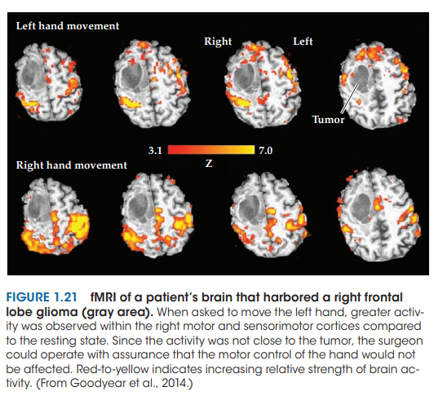
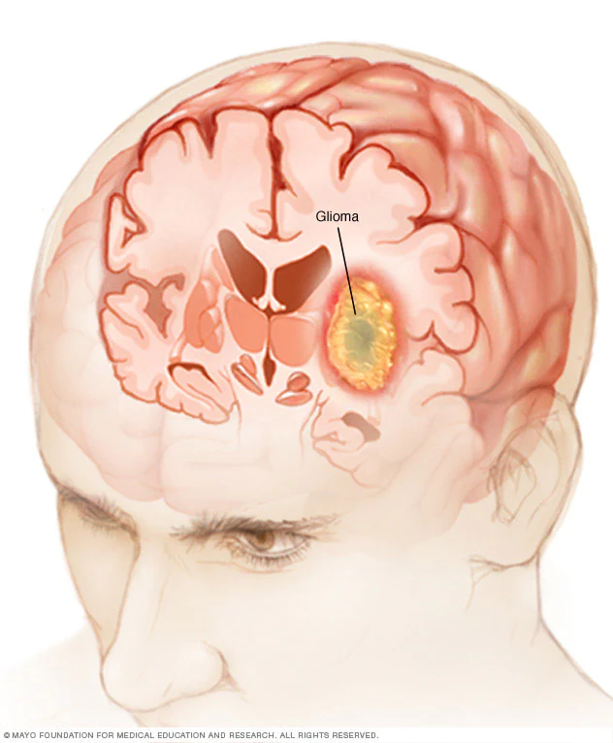
Functional brain imaging
– page 27 – only the part related to fMRI

Slide 36
Assigned reading questions
What is the function of microglial cells?
What do we mean by the neuron doctrine?
Mention 2 differences between intra- and extracellular recording.
What is BOLD?
5

Slide 37
What do we mean by the neuron doctrine?
advocates of the neuron doctrine claimed that the nervous system was composed of discrete cellular units. Proponents of the alternative reticular theory, on the other hand, argued that the entire nervous system was a continuous network of cells, without gaps or synapses between the cells.

Slide 38
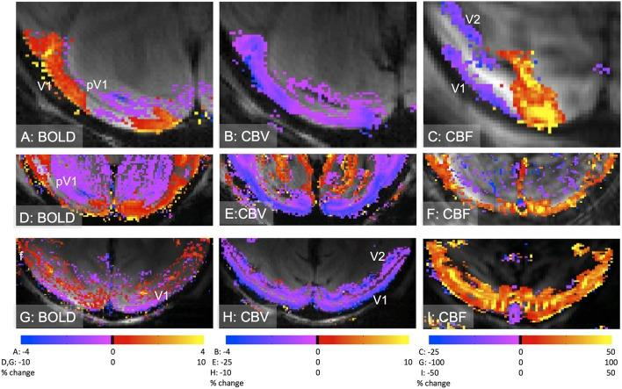
What is BOLD?
When a brain area is activated by a specific task, it begins to use more oxygen, and within seconds the brain microvasculature responds by increasing the flow of oxygen-rich blood to the active area. These changes in the concentration of oxygen and blood flow lead to localized blood oxygenation level– dependent (BOLD)

Slide 39
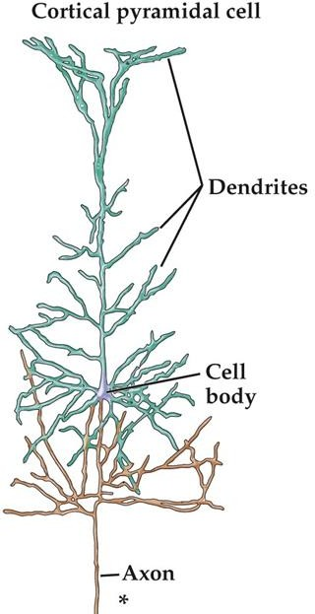
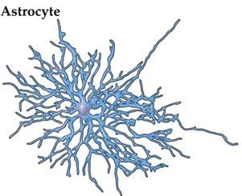
Neural tissues
Neurons vs. Glia
The brain contains about 86 billion neurons and at least that many glia
6

Slide 40
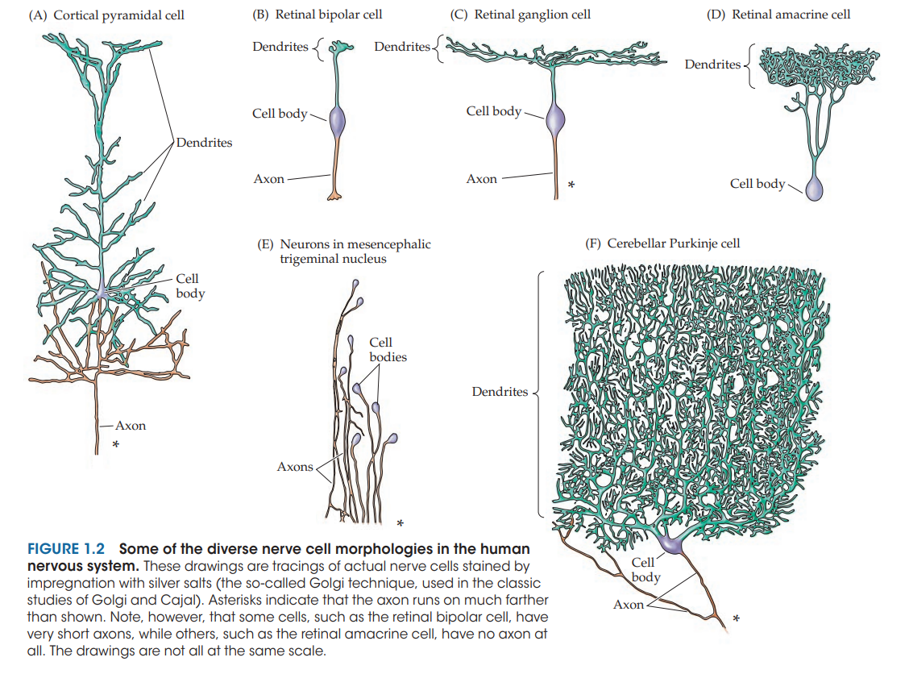
7

Slide 41
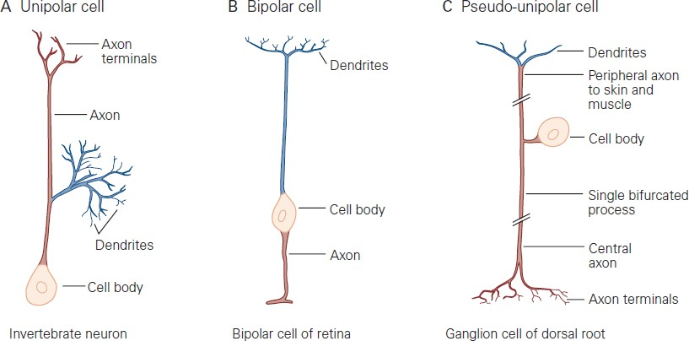
Neurons
8

Slide 42
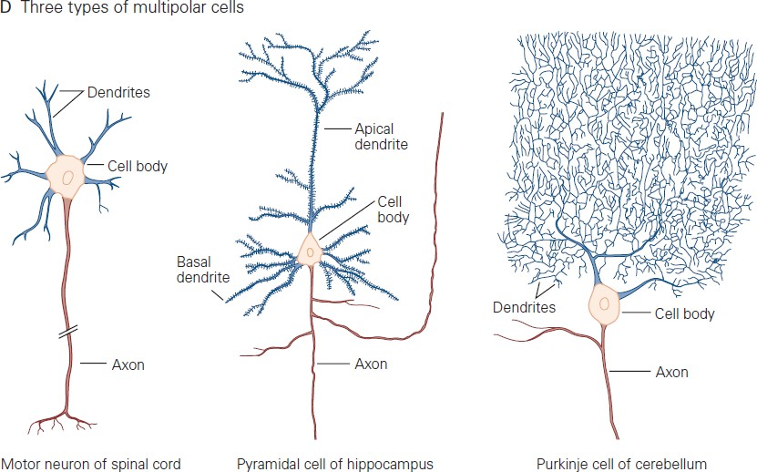
Neurons
9

Slide 43
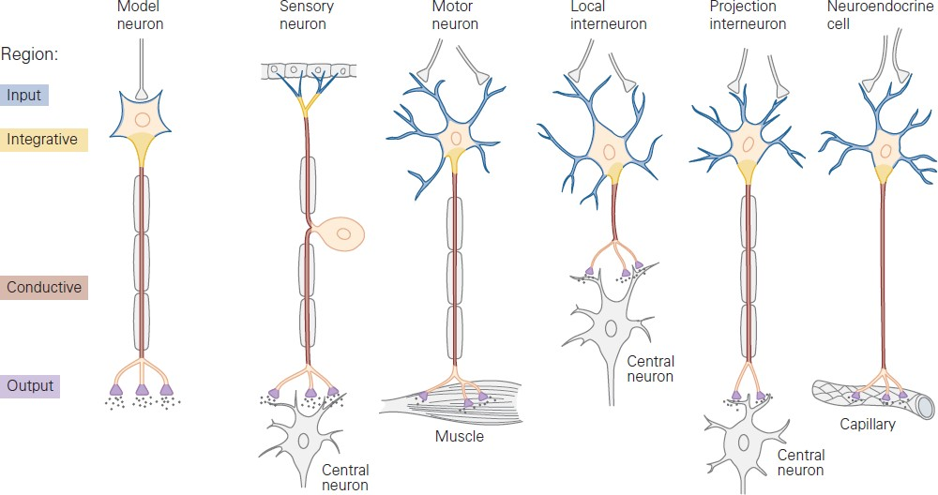
Functional regions
10

Slide 44
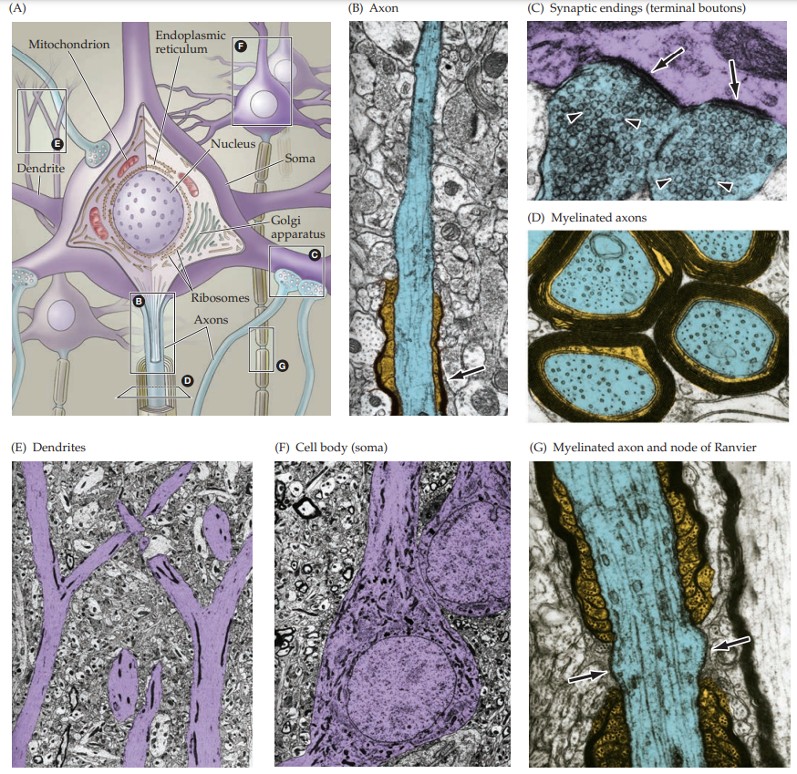
Major features of neurons as seen via microscopes
11

Slide 45
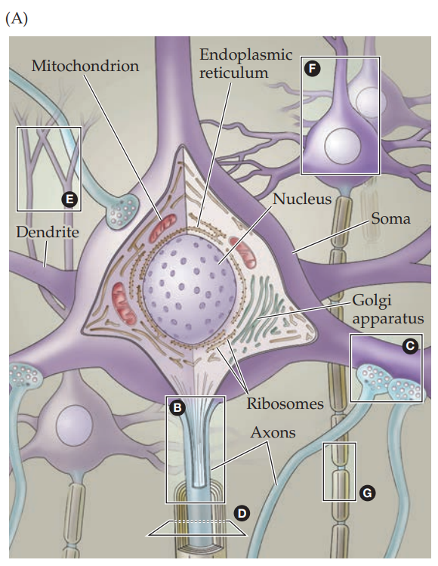
My concise :
The major features of neurons visualized with electron microscopy

Slide 46
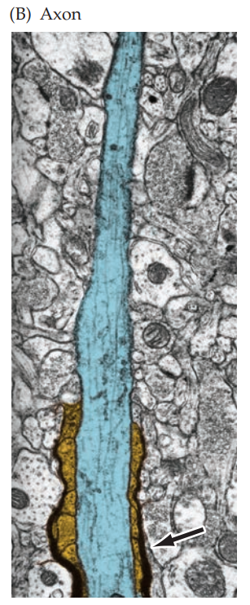
(B) Axon initial segment (blue) entering a myelin sheath (gold)

Slide 47
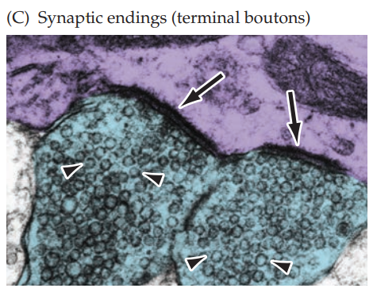
Terminal boutons (blue) loaded with synaptic vesicles (arrowheads) forming synapses (arrows) with a dendrite (purple)

Slide 48
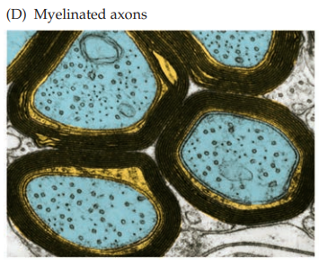
. (D) Transverse section of axons (blue) ensheathed by the processes of oligodendrocytes [myelinating cells of the central nervous system (CNS) ] (gold); the surrounding myelin is black

Slide 49
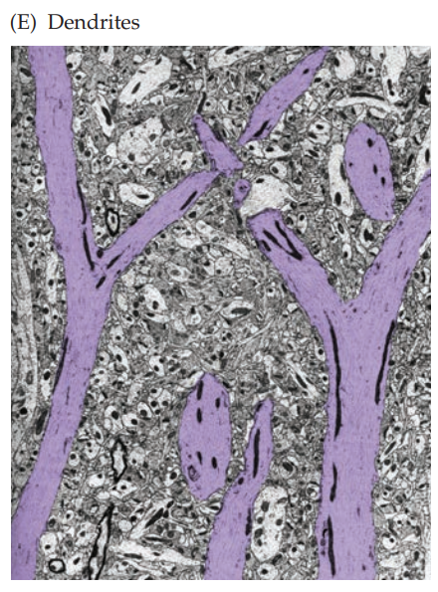
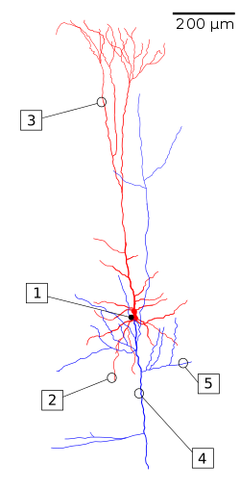
(E) Apical dendrites (purple) of cortical pyramidal cells.
a type of multipolar neuron found in areas of the brain including the cerebral cortex, the hippocampus, and the amygdala

Slide 50
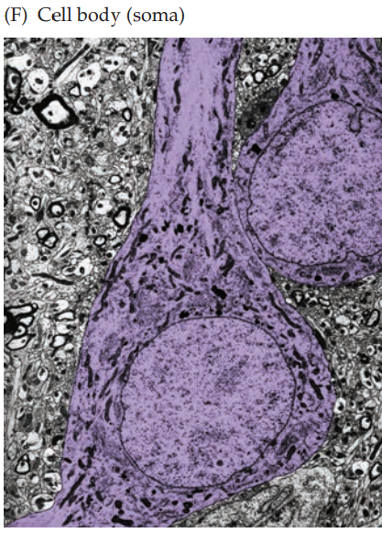
(F) Nerve cell bodies (purple) occupied by large round nuclei.

Slide 51
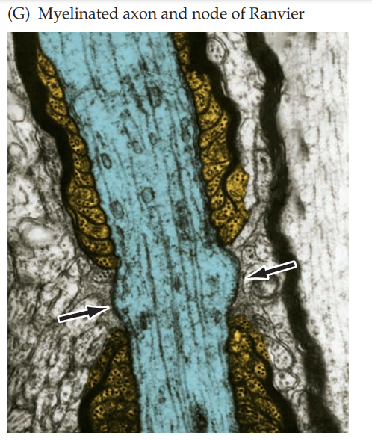
Portion of a myelinated axon (blue) illustrating the intervals that occur between adjacent segments of myelin (gold and black) referred to as nodes of Ranvier (arrows).

Slide 52
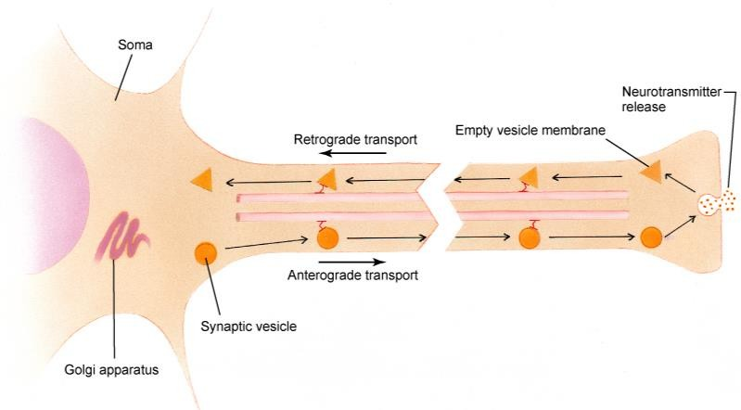
Axoplasmic transport
Similar to anterograde and retrograde amnesia
12

Slide 53
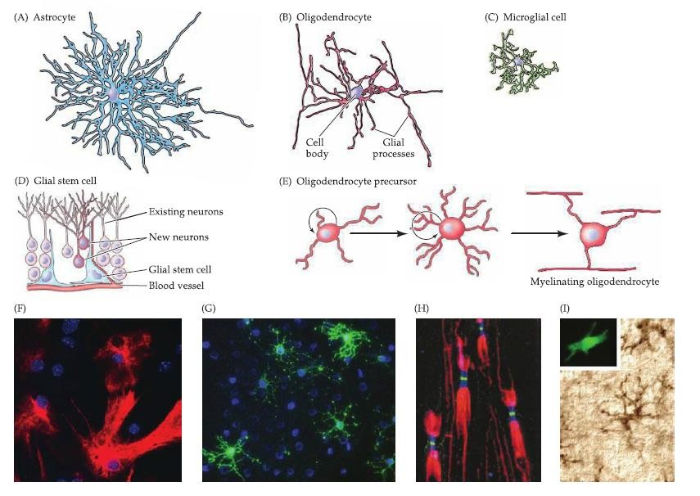
Glial cells
13

Slide 54
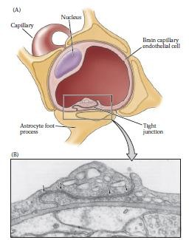
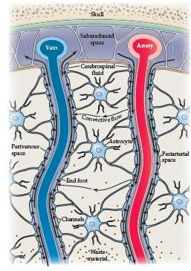
Blood-brain barrier
14

Slide 55
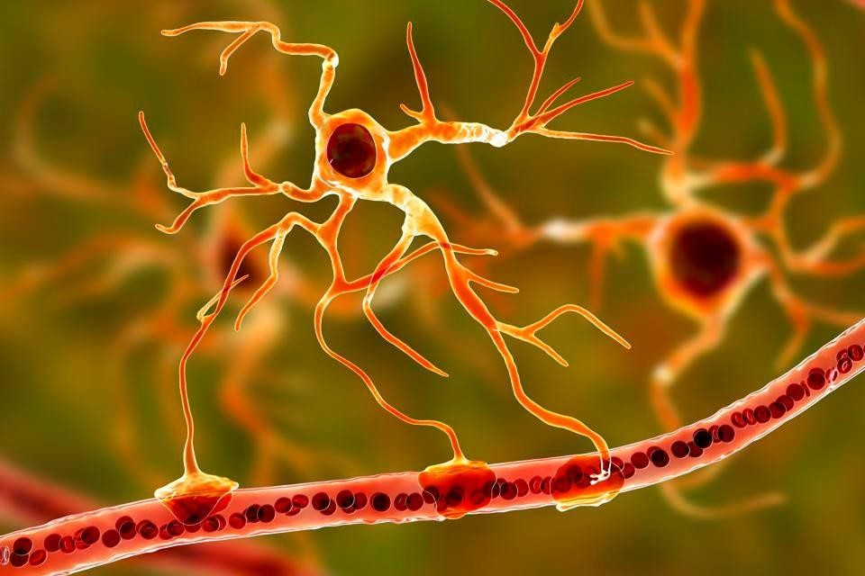
15

Slide 56
Brain clearing dead neurons
The team discovered that three types of cells pitched in, each having a different role. These were all glial cells, which surround and support neurons. In the first few hours after cell death, microglia swarmed over the main body of the dead neuron, to clear it away. Meanwhile, astrocytes cleaned up the connecting dendrites.
Meanwhile, NG2 cells would chip in as needed.
Read the following article
https://newatlas.com/medical/yale-video-brain-dead- neurons/
16

Slide 57

17

Slide 58

18

Slide 59

19

Slide 60
Methods of neuroscience studies
Several methods are used to study the nervous system of humans or other animals
A challenge is to integrate the diverse knowledge from different methods into a coherent understanding of brain structure and function
20

Slide 61

Visualizing nerve cells Staining techniques
Golgi method (silver salts)
Fluorescent dye
Nissl method (stains nucleolus only)
21

Slide 62

22

Slide 63


Knee jerk response
What are afferent fibers? Efferent?
23

Slide 64


Slide 65
The knee-jerk response, a simple reflex circuit. Formally known as the myotatic reflex
this response illustrates several points about the functional organization of neural circuits.
Mechanism :
Stimulation of peripheral sensors (a muscle stretch receptor in this case) initiates receptor potentials that trigger action potentials that travel centrally along the afferent axons of the sensory neurons. This information stimulates spinal motor neurons by means of ? synaptic contacts. The action potentials triggered by the synaptic potential in motor neurons travel peripherally in efferent axons, giving rise to muscle contraction and a behavioral response.
Purpose ?
One of the purposes of this particular reflex is to help maintain an upright posture in the face of unexpected changes (such as tripping).

Slide 66

Electrophysiological recording
Extracellular recording of nerve function Functional studies
shows the relative frequency and pattern of action potentials in neurons that form the neural circuits for the myotatic reflex
24

Slide 67

Action potentials are indicated by individual vertical lines. As a result of the
stimulus, the sensory neuron is triggered to fire at higher frequency (i.e., more action potentials per unit of time) → This increase triggers a higher frequency of action potentials in both the extensor motor neurons and the interneurons. Concurrently, the inhibitory synapses made by the interneurons onto the flexor motor neurons cause the frequency of action potentials in these
cells to decline.

Slide 68

Electrophysiological studies
Intracellular recording of nerve function
Functional studies
25

Slide 69

A) Action potential measured in a sensory neuron. (B) Postsynaptic potential recorded in an extensor motor neuron. (C) Postsynaptic potential recorded in an interneuron. (D) Postsynaptic potential recorded in a flexor motor neuron. Such intracellular recordings are the basis for understanding the cellular mechanisms of action potential generation, and the sensory receptor and synaptic potentials that trigger these conducted signals.

Slide 70

Structural analysis
Lesion studies
H.M., surgery to treat epilepsy, bilateral medial temporal lobectomy [aim to remove the area of the brain ], anterograde[directed forwards in time] amnesia
Phineas Gage, railroad accident, left frontal lobe injury, changes in personality and behavior
Lobotomy, surgery used to treat mental disorder, caused personality and intellectual problems
26

Slide 71

https://neurosciencenews.com/long-term-memory-neurons- 17398/
27

Slide 72


Structural analysis
Tracing studies (anterograde or retrograde)
28

Slide 73

Functional analysis –
electrophysiological studies
Receptive field, receptive field properties
29

Slide 74

Magnetic resonance imaging
30

Slide 75


Magnetic resonance imaging
Diffusion tensor imaging (DTI); a variant of MRI used to visualize axon pathways
3
1

Slide 76

Functional brain imaging
fMRI
32

Slide 77

Functional brain imaging
fMRI
33

